Slide 1
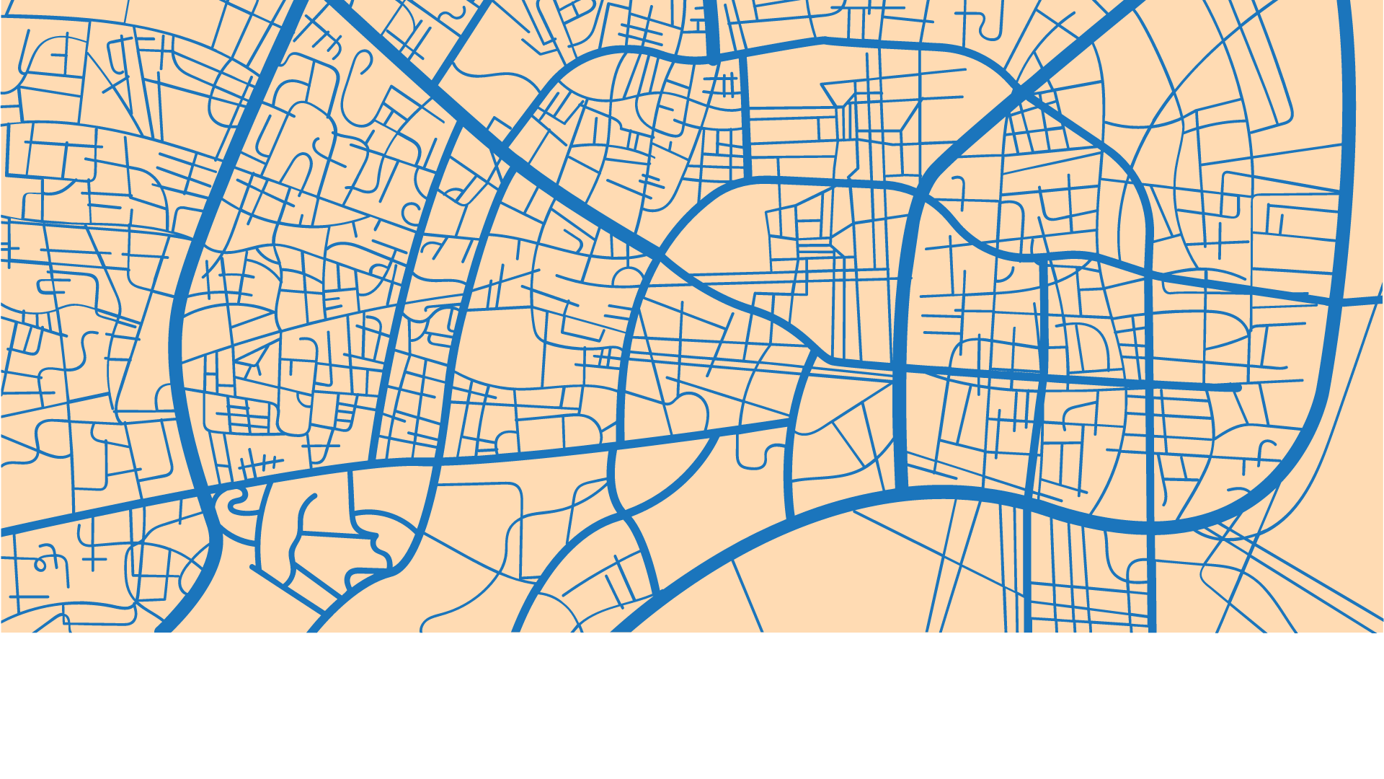
Vintage Geography
MOVE SMART
Tuesday, 12 September 2023
2023
A Presentation about Geography by:
Jane Doe
A presentation about transportation by
: HIRWA Joric
A Seamless Booking Experience

Slide 2

AGENDA
SECTION 1
Introduction
Problem Statement
Solution Overview
SECTION 2
Booking Features
Real Time Updates
SECTION 3
Future Prospects
Conclusion
Q&A

Slide 3
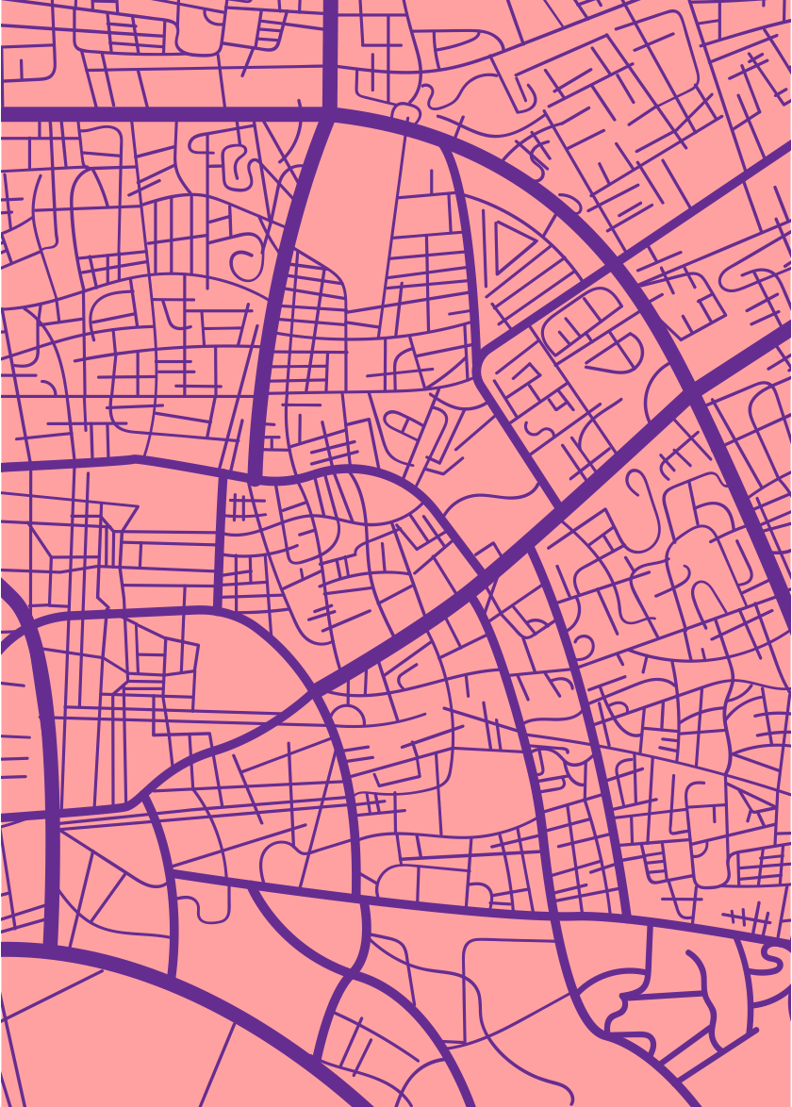

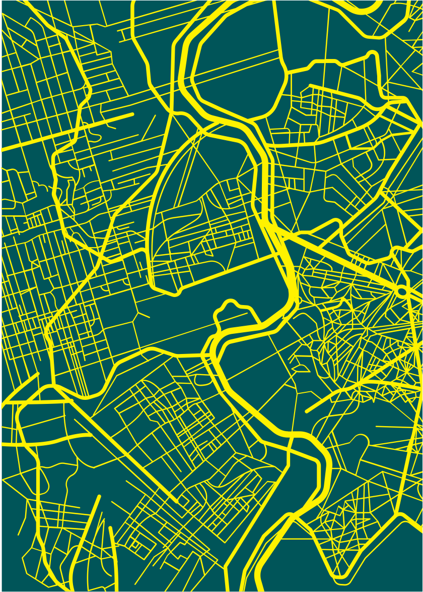
SECTION 1
SECTION 2
SECTION 3
Introduction
Problem Statement
Solution Overview
Booking Features
Real Time Updates
Future Prospects
Conclusion
Q&A

Slide 4

INTRODUCTION
SIMPLE OVER VIEW

Slide 5
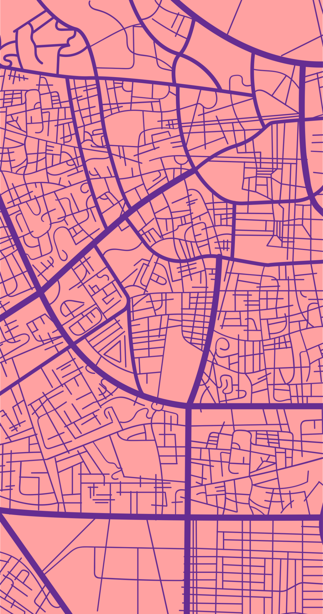
Welcome To
Move Smart
Imagine standing for hours at a bus station in Kigali, uncertain if you'll get a seat or even reach your destination on time. In Rwanda, where public transportation is vital, such challenges are all too common. Today, we introduce MOVE SMART, a digital revolution designed to transform this experience. Crafted by , Team SmartMovers our platform promises not just a ride, but an informed, seamless journey for every Rwandan commuter. Let's embark on this transformative ride together.
Transportation should be a convenient, stress-free experience for everyo﻿ne.

Slide 6
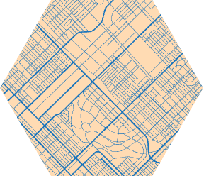

PROBLEM STATEMENT
Introduction to the Issue:
Public transportation is the lifeblood of Rwanda's urban centers, connecting people to opportunities, services, and each other.
Impact of the Problem:
The ripple effects of these challenges are profound. Beyond the evident time wastage, there's a mental toll - the stress of uncertainty, the frustration of missed opportunities, and the sheer exhaustion from unnecessary waiting.
Specific Challenges:
Unpredictability: Commuters are often left in the dark, unsure of when the next bus will arrive or if they'll secure a seat. This unpredictability disrupts schedules and plans.
Time-Consuming Queues: The traditional ticketing system forces many to stand in long, winding queues. Precious hours are lost, hours that could be spent productively or with loved ones.
Lack of Information: Without real-time updates or a centralized platform, travelers are left to rely on word of mouth or sheer luck to navigate their journeys.
Personal Evidence:
Take the case of Samuel, a student who missed an important exam because he couldn't anticipate the bus delays. Or Aisha, a mother who frequently gets home late, missing precious moments with her children, all because of unpredictable bus schedules.
Statistical Evidence:
While we may have individual stories, they're part of a larger narrative. A recent survey highlighted that 8 out of 10 Rwandans face transportation-related challenges weekly, emphasizing the scale and urgency of the issue.
Transition to the Solution:
With such pressing challenges affecting a majority of our population, the need for a transformative solution has never been more evident.

Slide 7
Solution Overview
Introduction to the Solution:
Enter Move Smart, the dawn of a new era in Rwandan transportation.
Core Functionality:
At its heart, Move Smart is a beacon of digital transformation, designed to seamlessly connect Rwandans with their transportation needs, ensuring every journey is predictable and efficient.
Key Features:
Instant Booking: Gone are the days of uncertainty. With just a few taps, secure your seat and be on your way. No queues, no fuss.
Real-time Insights:Empower yourself with live updates. Know when your bus is arriving, how many seats are available, and plan your schedule with precision.
Digital Ticketing Revolution: Step into the future with our digital ticketing system. Safe, eco-friendly, and always at your fingertips. Never worry about losing a paper ticket again.
Comprehensive Scheduling:Our platform offers a holistic view of bus schedules, ensuring you're always in the know. Whether it's planning daily commutes or occasional trips, we've got you covered.
User Experience:
With an intuitive design, Move Smart is more than just an app; it's a companion. Crafted with every Rwandan in mind, its simplicity ensures that everyone, from our youth to our elders, can navigate with ease.
Benefits Recap:
With Move Smart, we're not just introducing an app; we're pioneering a movement. A movement towards informed decisions, saved time, reduced stress, and a greener Rwanda.

Slide 8

DEMO
CURENT PROGRESS

Slide 9



Timeline
Add a main point
Briefly elaborate on what you want to discuss.
Add a main point
Add a main point
Briefly elaborate on what you want to discuss.
Briefly elaborate on what you want to discuss.

Slide 10

OUTLOOK
Concluding Remarks and Future Directions

Slide 11
Future Prospects
Our Vision:
As we stand on the cusp of a transportation revolution in Rwanda with Move Smart, we envision a future where our platform becomes the gold standard for transportation solutions, not just in Rwanda, but across the African continent..
Expansion Plans:
Our roadmap includes aggressive expansion. Starting from Kigali, we aim to cover every major city in Rwanda within two years. And by year five? We see Move Smart making waves in neighboring countries, transforming transportation across East Africa.
Planned Features & Enhancements:
Integrated Travel: Beyond buses, we're looking to integrate with trains, taxis, and even bike-sharing services, offering users a comprehensive travel solution.
Smart Predictions: Harnessing the power of AI, we aim to provide users with predictive travel insights, suggesting optimal travel times and routes based on traffic patterns and user behavior.
Partnerships & Collaborations:
We're actively exploring collaborations with leading mobile payment platforms, ensuring users have a plethora of payment options. Additionally, discussions are underway with Rwanda's transportation authorities for potential integrations, ensuring a unified and streamlined experience for all.

Slide 12
continuation
Sustainability & Scalability:
With a robust revenue model anchored in value-driven services, we're poised for sustainable growth. Our cloud infrastructure ensures that as we grow, our services remain seamless, accommodating millions of users without a hitch.
Addressing Future Challenges:
As urban dynamics evolve, so will challenges. Be it changes in transportation regulations, urban planning, or technological advancements, we're committed to continuous innovation, ensuring Move Smart remains not just relevant, but indispensable.
Closing Statement:
With Move Smart,, we're not just offering a service; we're crafting the future of transportation. A future where every journey is predictable, every route is efficient, and every user is empowered.

Slide 13
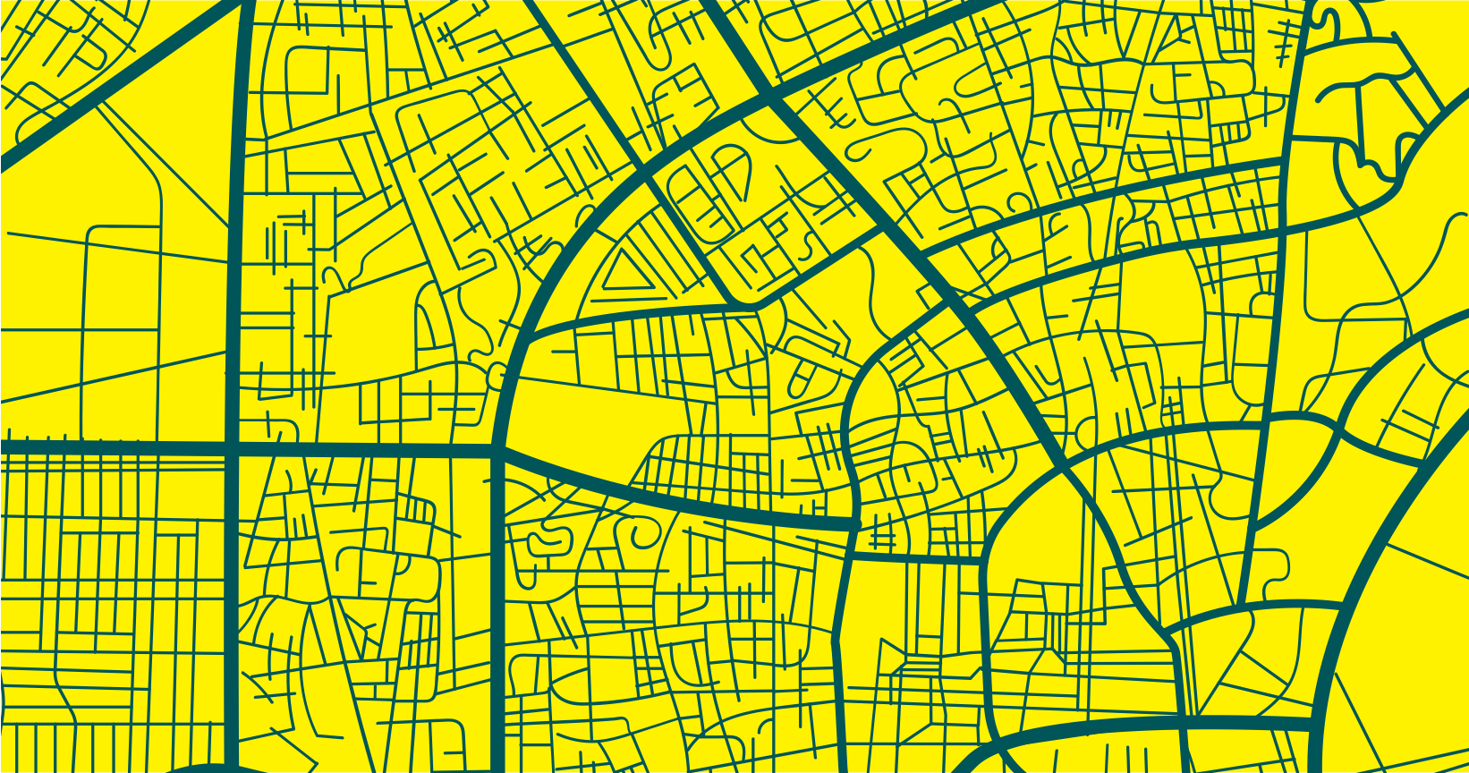
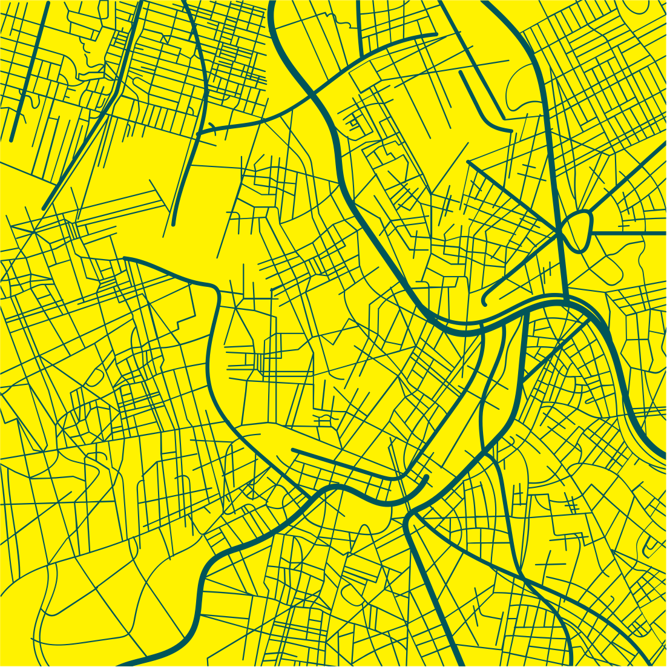
Conclusion
In our journey today, we've delved deep into the transportation challenges that touch the daily lives of countless Rwandans. We've unveiled Move Smart, not just as a solution, but as a beacon of transformation for our nation's commuting landscape. This platform isn't merely about booking rides; it's about reclaiming time, ensuring safety, and bringing predictability to the unpredictable. As we stand at the precipice of this transportation revolution, we invite each one of you to be a part of it. Experience the change, champion the innovation, and let's collectively drive Rwanda into a future where every journey is a testament to efficiency and innovation. Thank you for sharing this vision with us today. We're eager to hear your thoughts, answer your queries, and together, shape the future of transportation in our beloved Rwanda.

Slide 14

Q&A
We appreciate the engagement and interest you've shown in Move Smart. We're now open to delve deeper into any aspects you'd like to explore. Please, let's hear your questions.

Slide 15





Take me back
Plans
Summer '12
Gallery
Image
Camping

Slide 16
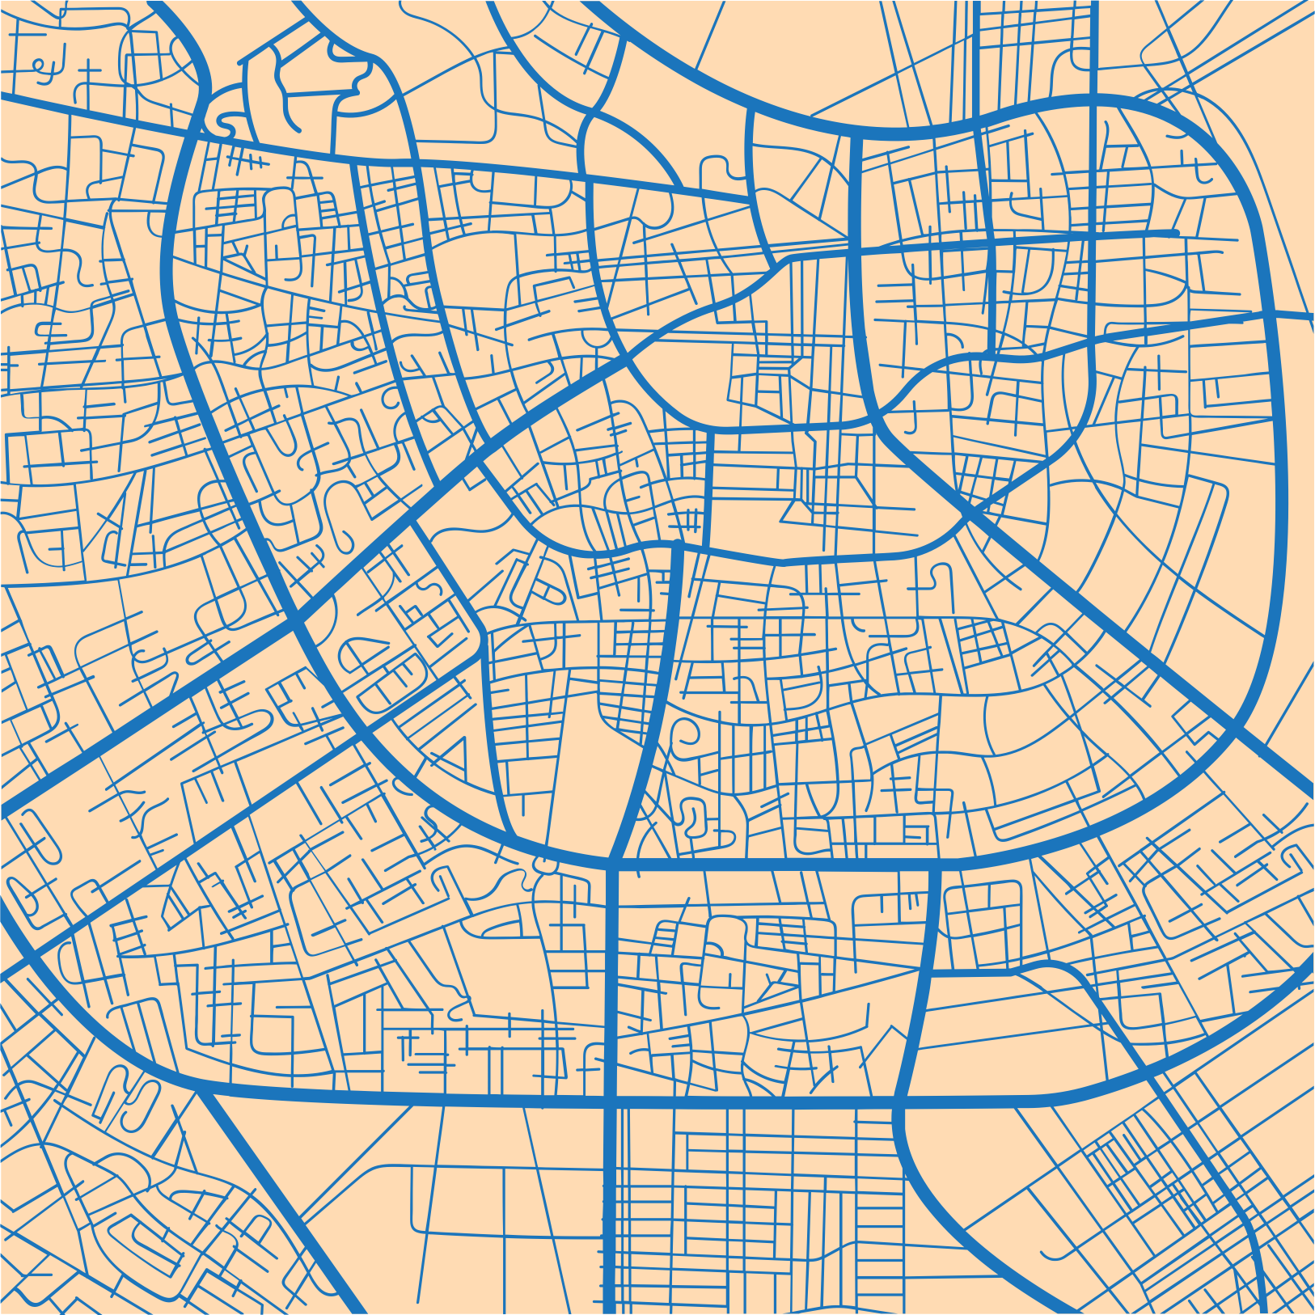


Contact Us
Address Musanze - Rubavu Road
City Nyabihu
Country Rwanda State Western Province
Latitude -1.6007338 Longitude 29.5147967
250784976100
gakundohope5@gmail.com
coming soon

Slide 17
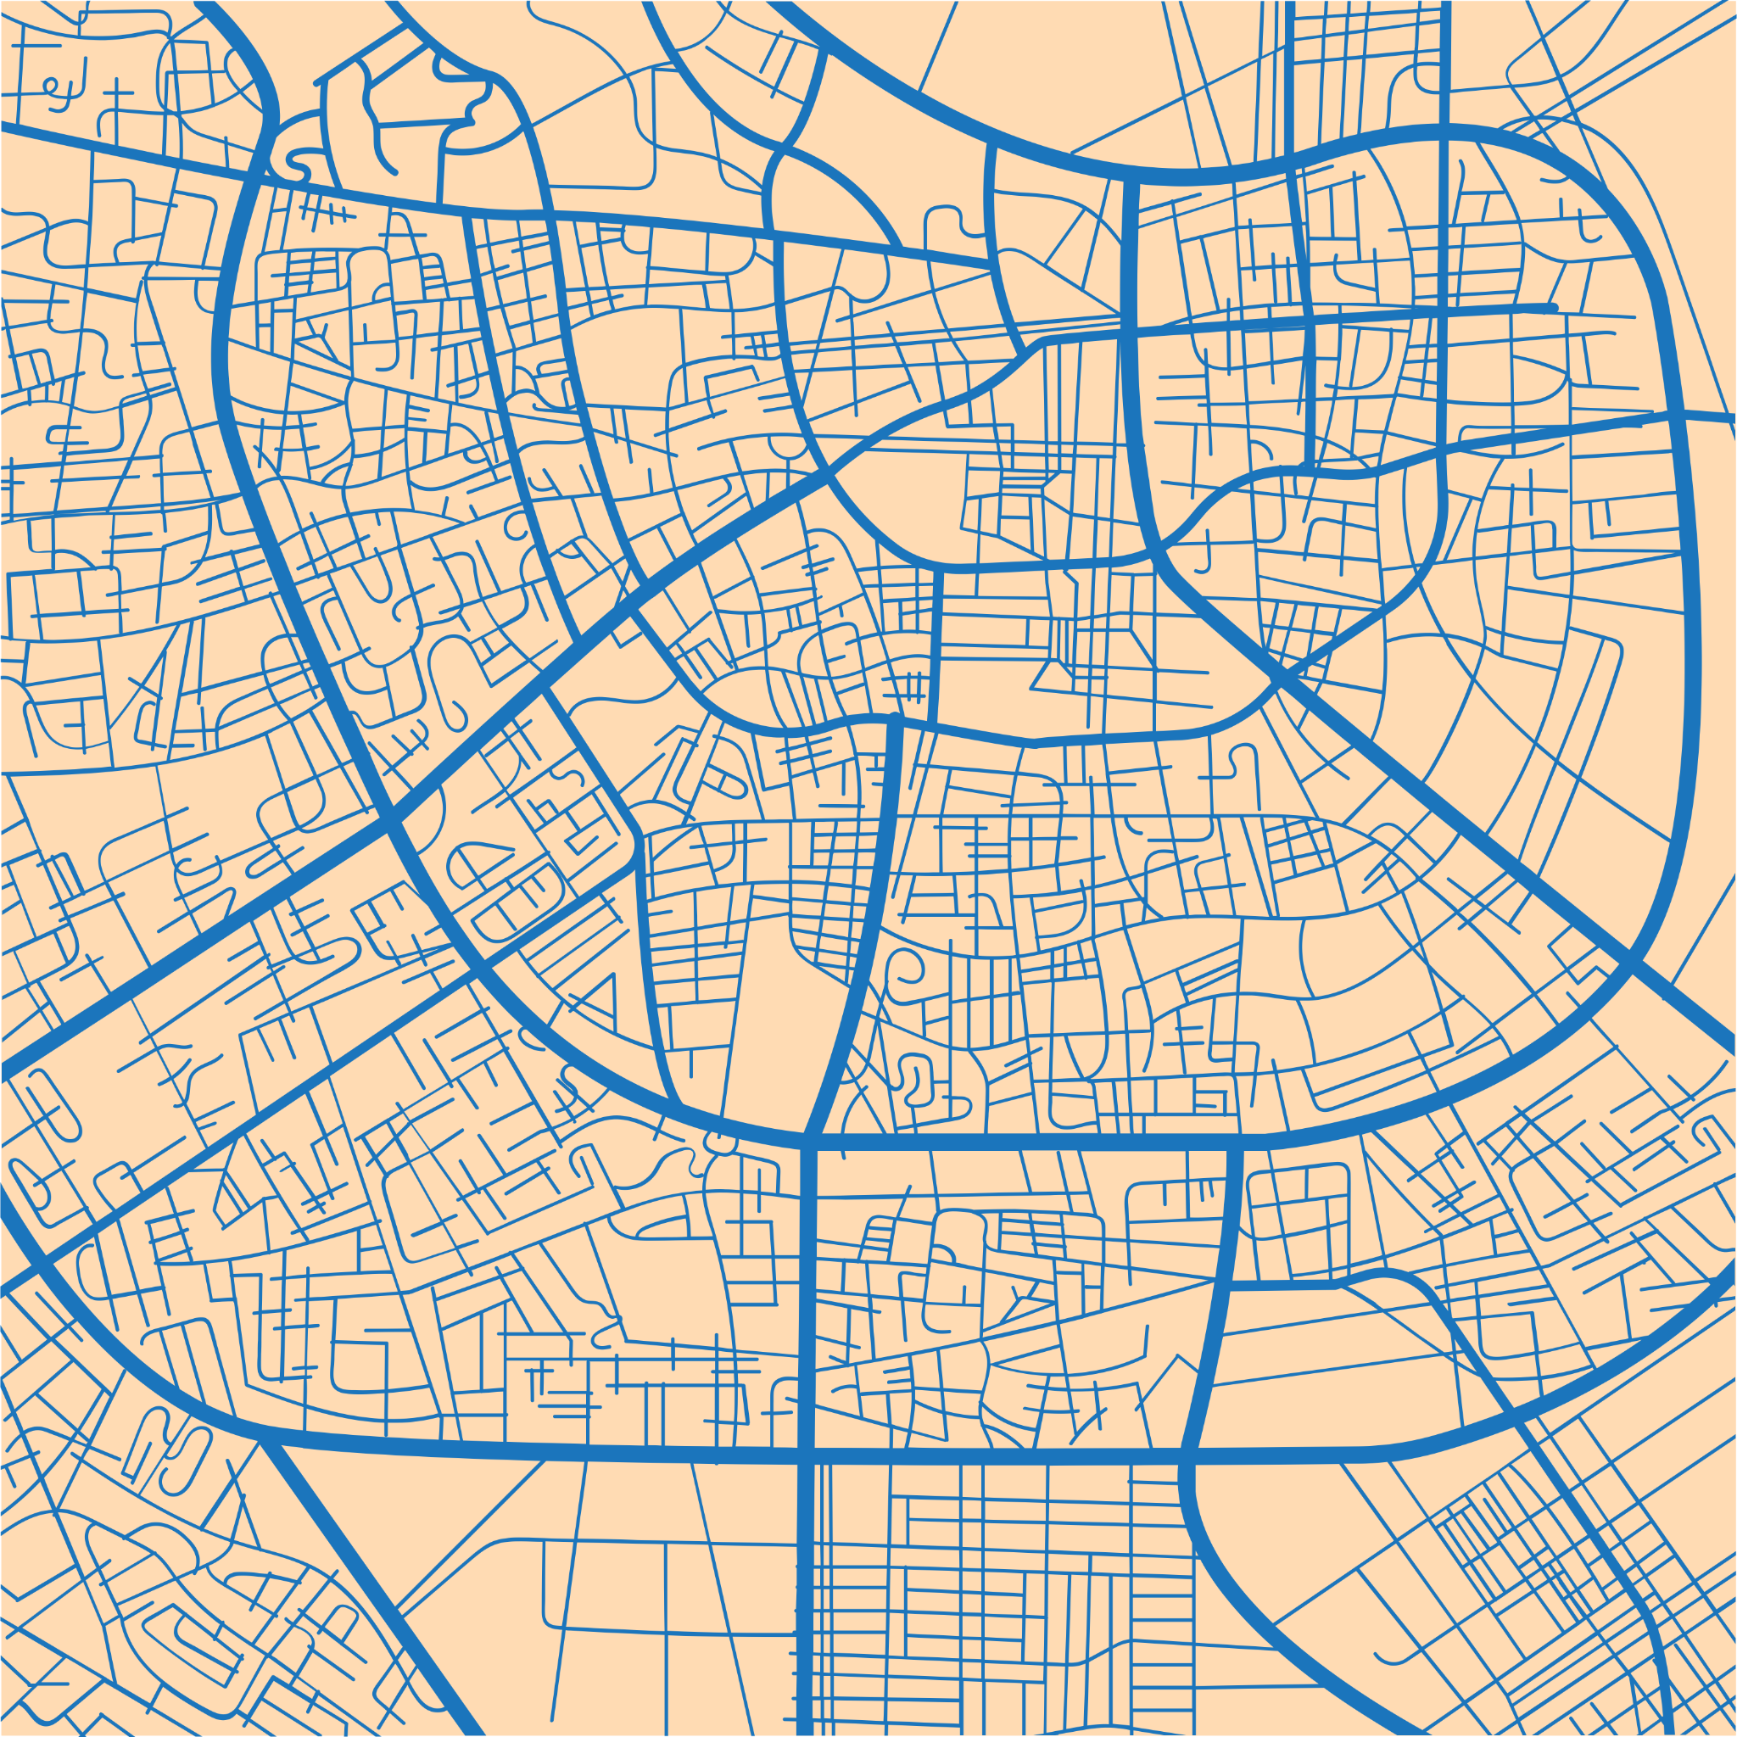
Thank you for your invaluable time and insights today. Your engagement truly drives our mission with Move Smart forward. We're eager for continued collaboration and feedback. Let's together shape a brighter transportation future for Rwanda. Once again, heartfelt thanks.

